Slide 1
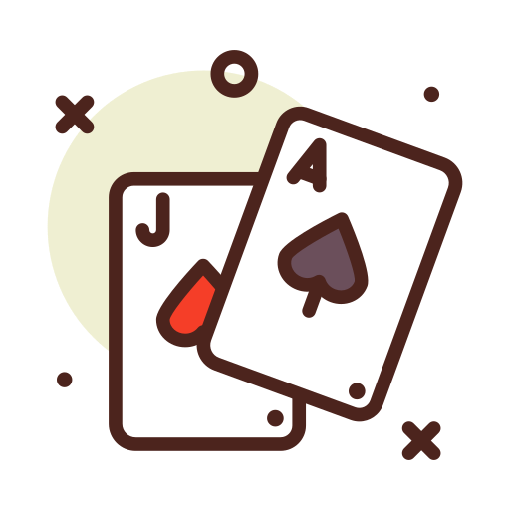
Group 2
Manuel G, Paul C, Nick V
Multiplayer Blackjack
Implementation

Slide 2
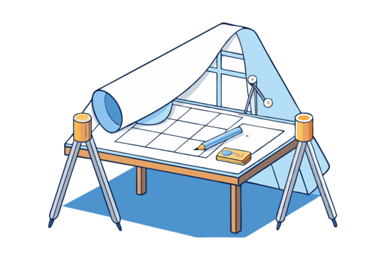
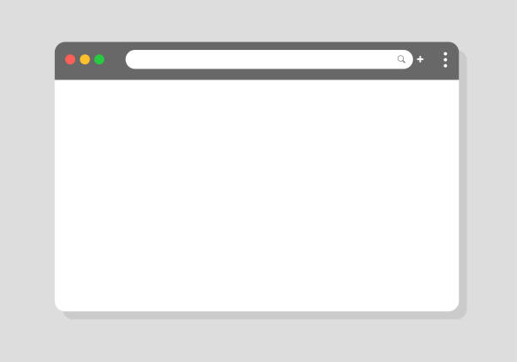





Introduction
Translating Design
Implementation & Testing
How did we deliver?
From ideas to canvas, bringing the design to life
Did our vision get realized? Did our tests and work reflect that?
Did we provide on our promise?

Slide 3
Networking
Hardest piece to get work working, and bottleneck for other parts of the project.
Successfully implemented
  Singleton
    Server is a single source of truth.
    Prevents other versions of the class from running within this current instance of the application
  Multithreaded Socket
    Allows for Multiple clients to connect simulataneaosly and for the server
  Object over Socket
    Server side messaging setup to translate any client message into an action a reply with a corresponding message
    Client side messaging servers messages into client state.

Slide 4
Networking
Network Implementation issues:
  Getting the Client side listener and sent thread to work together
Unexpected networking issues
Broadcasting message to multiple users simultaneously
  Needs to be done server wide to announce tables to each client
  Need to create subgroups for broadcast messages on a per table basis to announce other player and dealer actions.

Slide 5

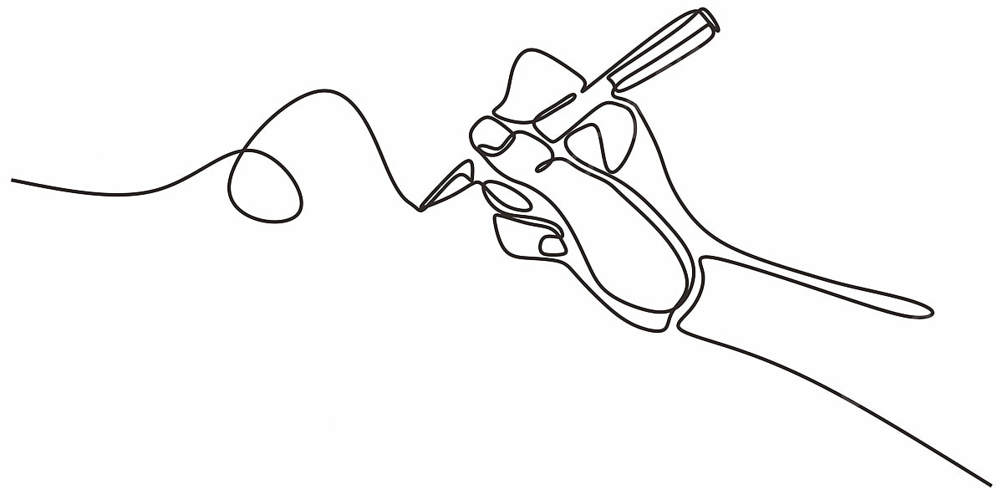

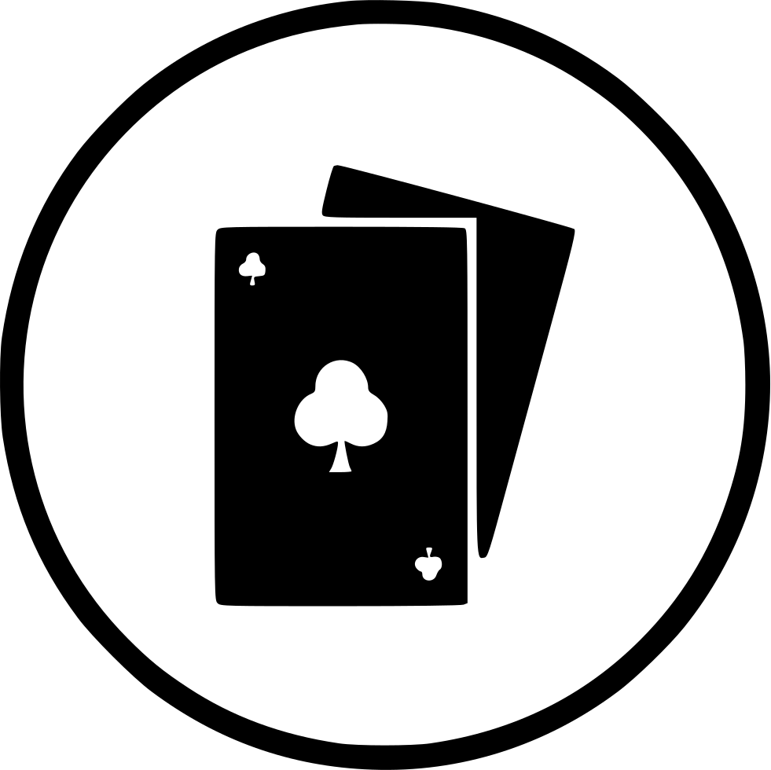
Game Logic
Blackjack Concepts
Design to Code
JUnit Testing
Translation of known ideas to technical processes
Functionally making Blackjack work
Challenges in covering cases and conditions
Initial expectations needed revisions to become transferable to code
New knowledge and obstacles led to various design changes
Bridging the gap between modules
Quickly became important to the goal of reliable game functionality
Automation/varied test cases were unexpectedly major bonuses

Slide 6

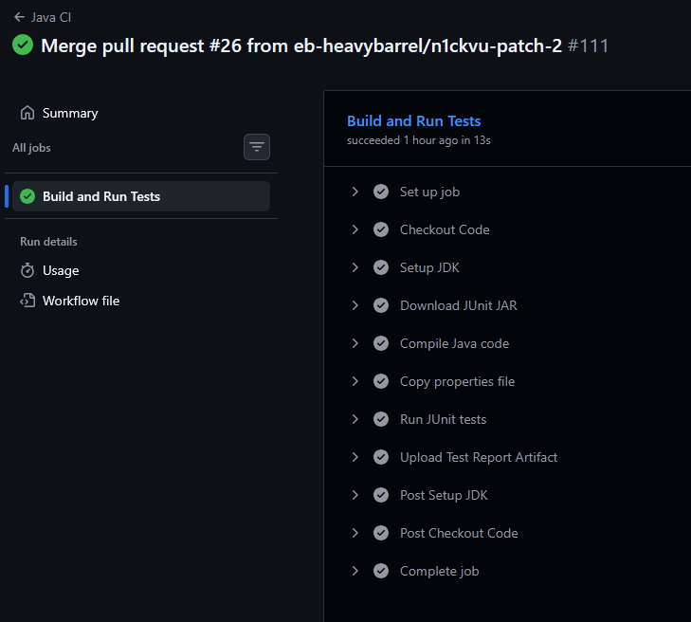



Game Logic Cont.
Design is Key
Major lesson from making a design to mapping out the program
Game Dev Prior Experience versus Building From Scratch
Valuable learning moment
JUnit Testing Successes

Slide 7
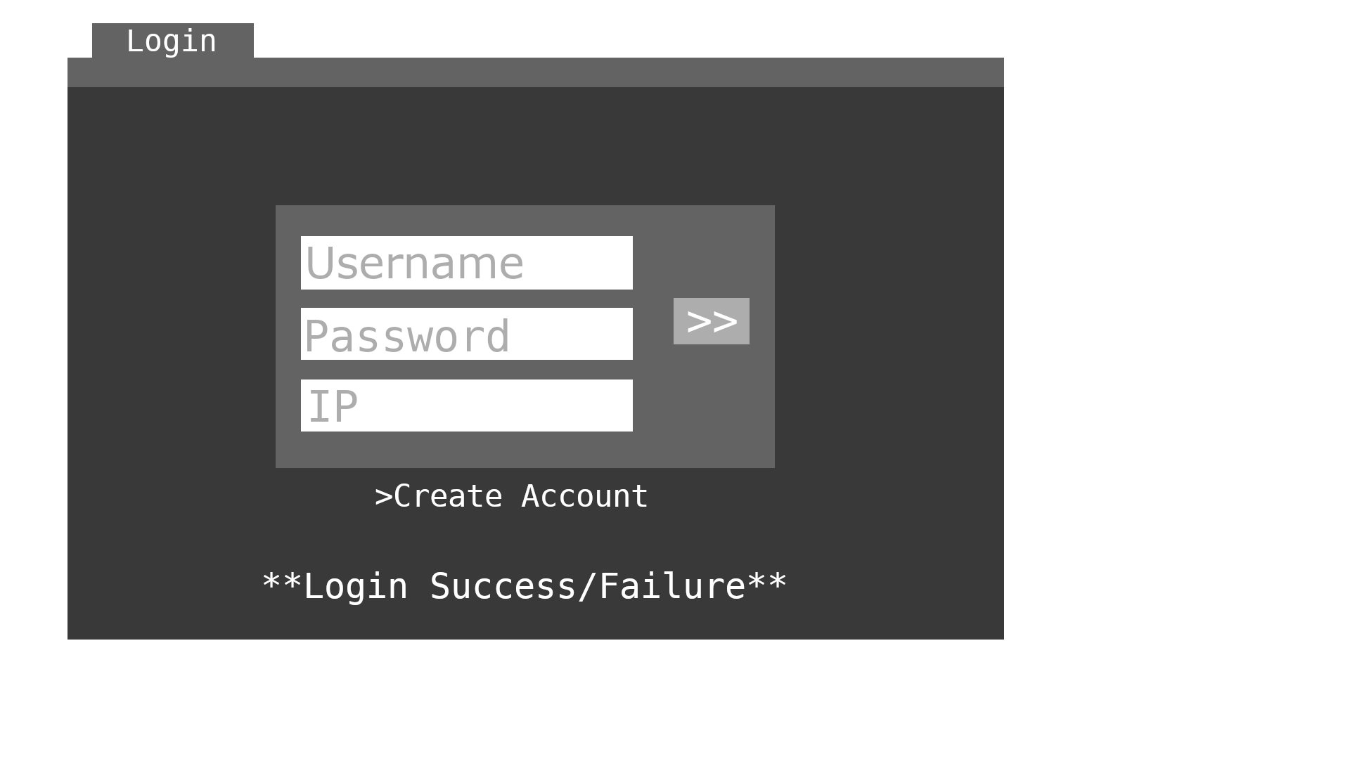
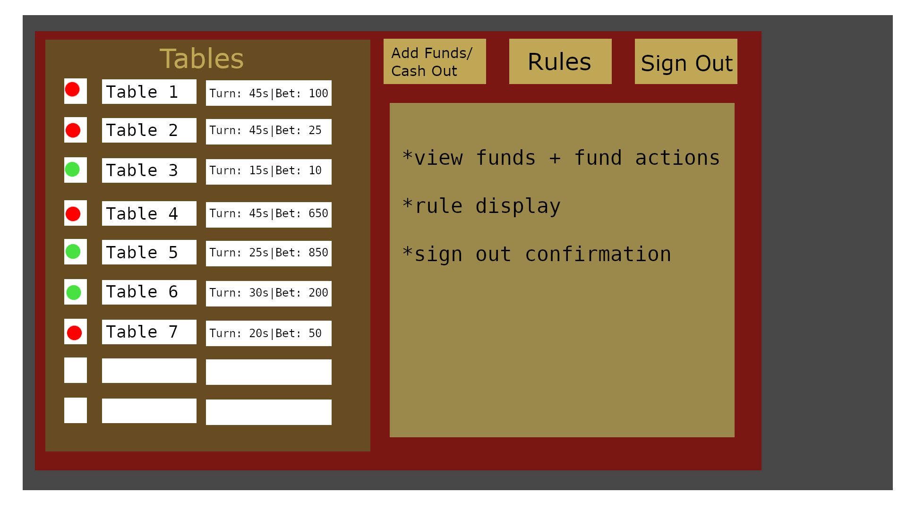
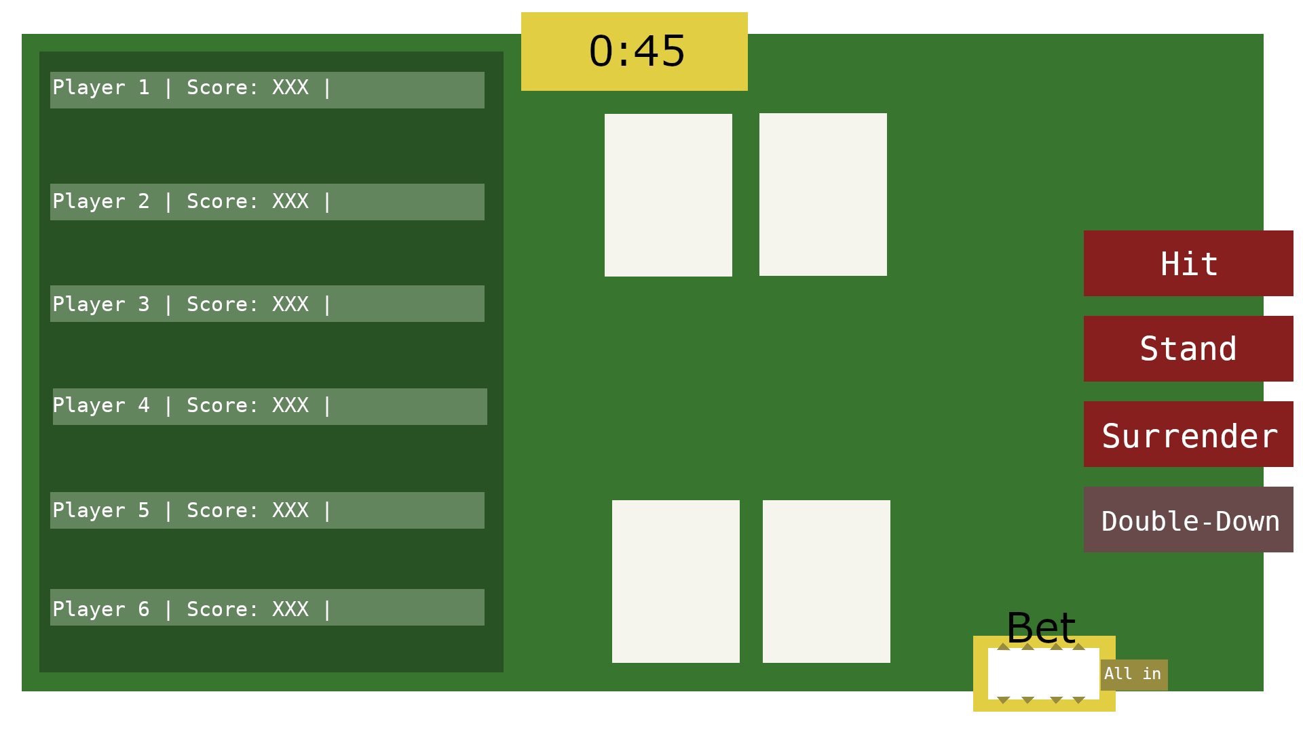
GUI Mock-ups

Slide 8
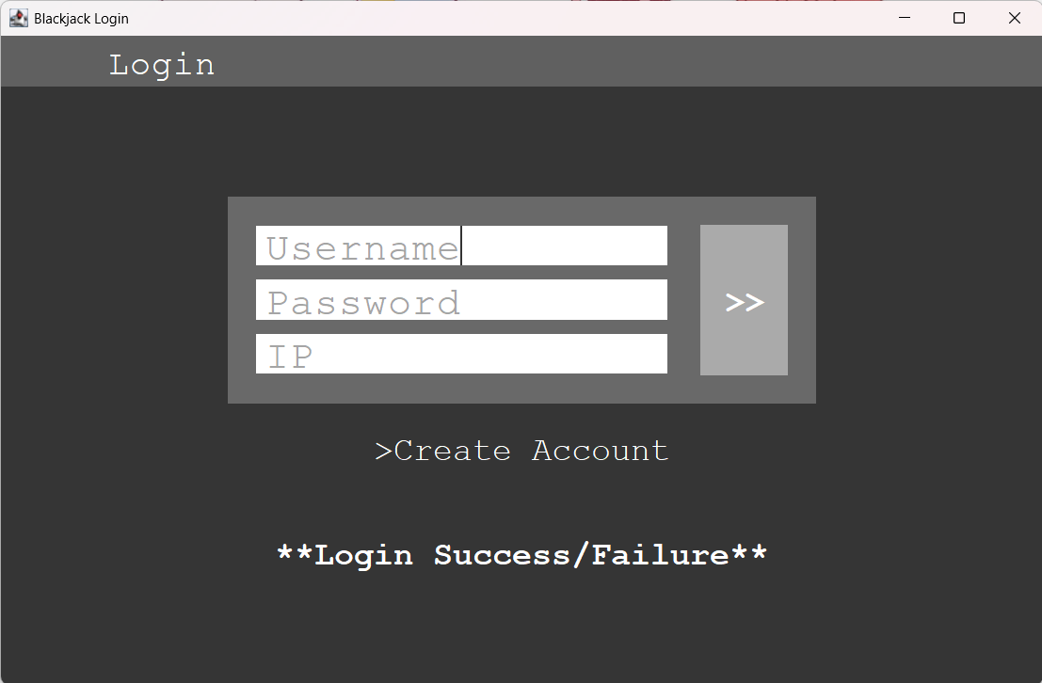
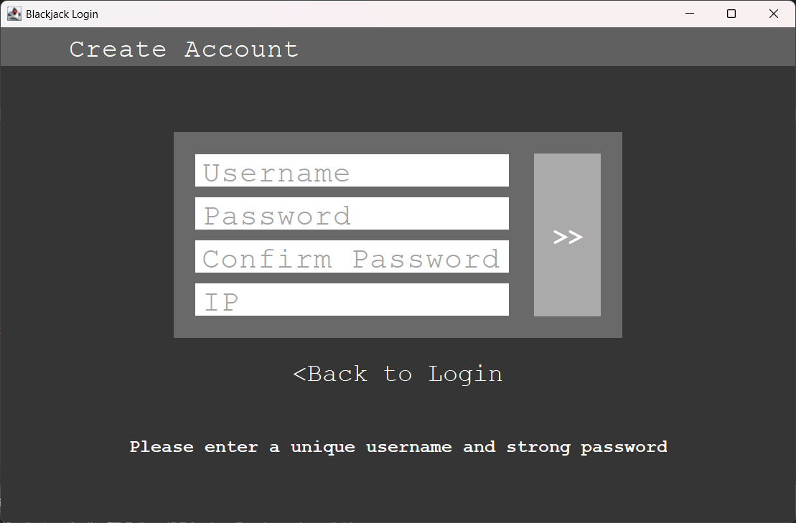
GUI - Login

Slide 9
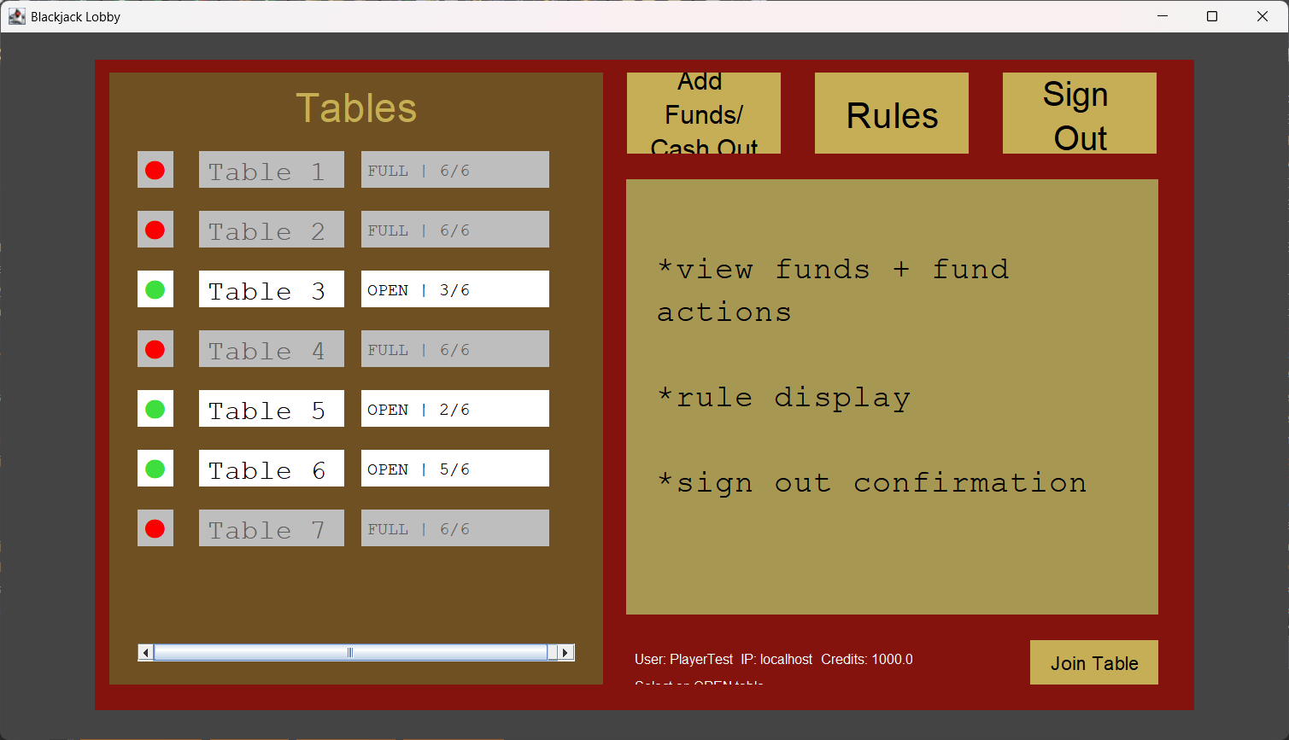
GUI - Lobby

Slide 10
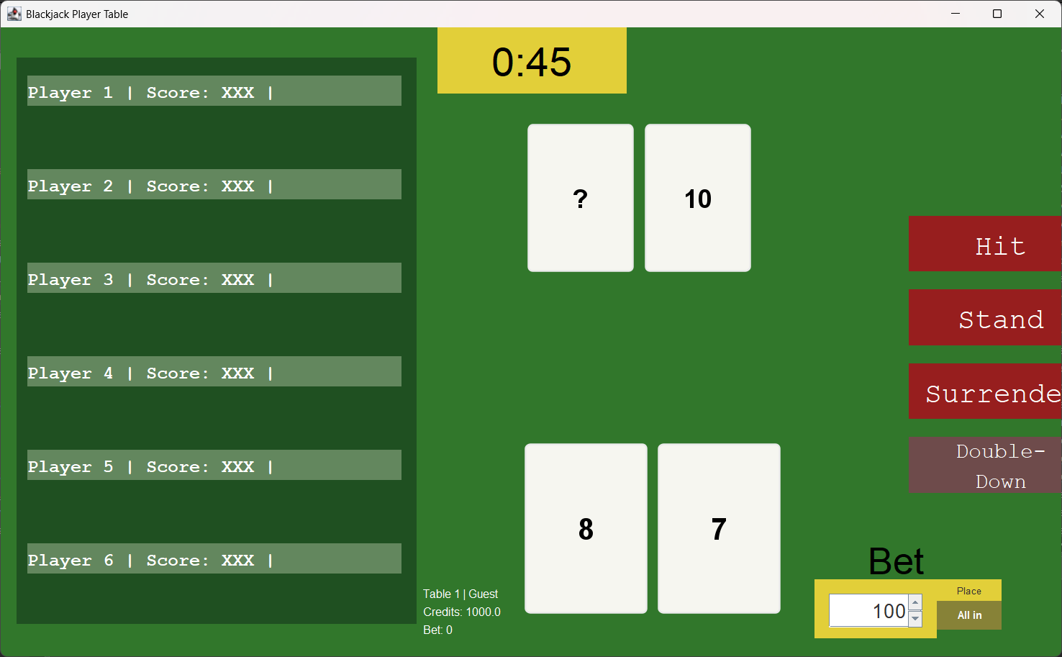
GUI - Player

Slide 11
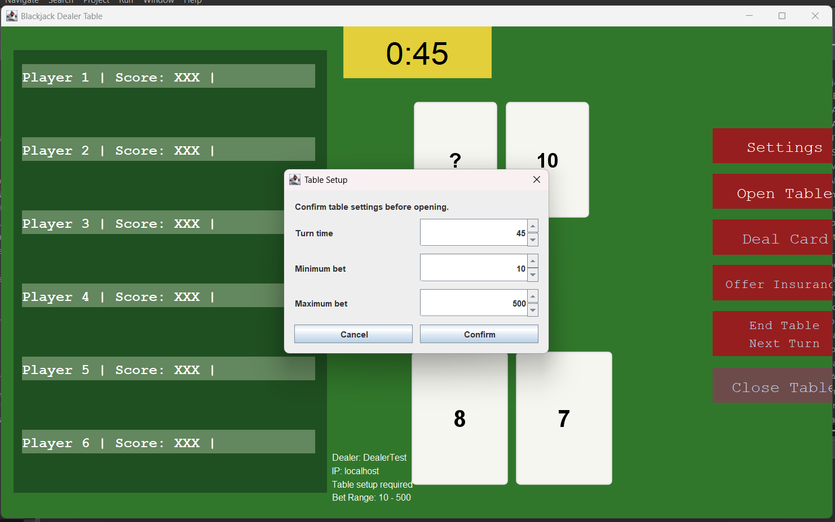
GUI - Table (Dealer)

Slide 12
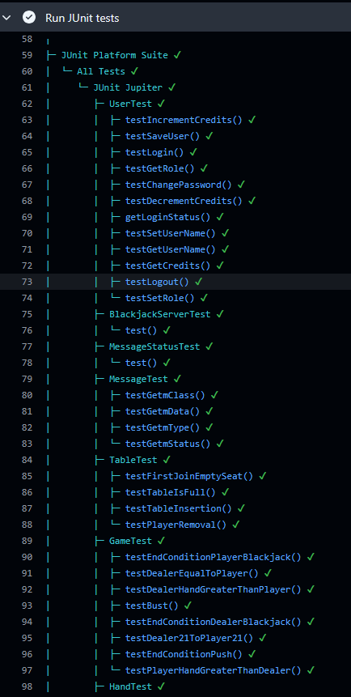
Closing & Retrospective
From CS401 - Successfully implementing design patterns, tackling program design
Outside CS401 - synchronizing, broadcast messages, research considerations for modeling the game
UI/UX Perspective + Scope
Implementation Issues
Design Changes and Shifting Priorities

